Slide 1


领受永恒之家的祝福
2026年2月15日

Slide 2
领受永恒之家的祝福
Receive the blessings of eternal Home
诗篇84：1-12
Psalm84：1-12
2

Slide 3

3

Slide 4
一渴想回家之福（v1-4）
1 从渴想到欢呼.
2 从祭坛到抱雏之窝
3 便为有福

Slide 5
一The Blessing of Longing to Return (vv. 1–4)
1 From Longing to Joyful Praise.
2 From the Altar to a Nest for the Young
3 Blessed Are Those Who Dwell in His House

Slide 6
二 迈向归家之旅（V5-8）
1从流泪谷到泉源之地。
2从得力之处到得力之处：
3 便为有福

Slide 7
The Blessing of the Journey (vv. 5–8)
1 From the Valley of Tears to Springs of Water.
2 From Strength to Strength
3 Blessed Are Those Who Set Out

Slide 8
三永享住家之乐（V9-12）
1从祈求到敬拜：
2从今生到永恒
3 便为有福

Slide 9
一The Joy of Dwelling Forever (vv. 9–12)
1 From Petition to Worship
2 From This Life to Eternity
3 . Blessed Are Those livingin His temple

Slide 10
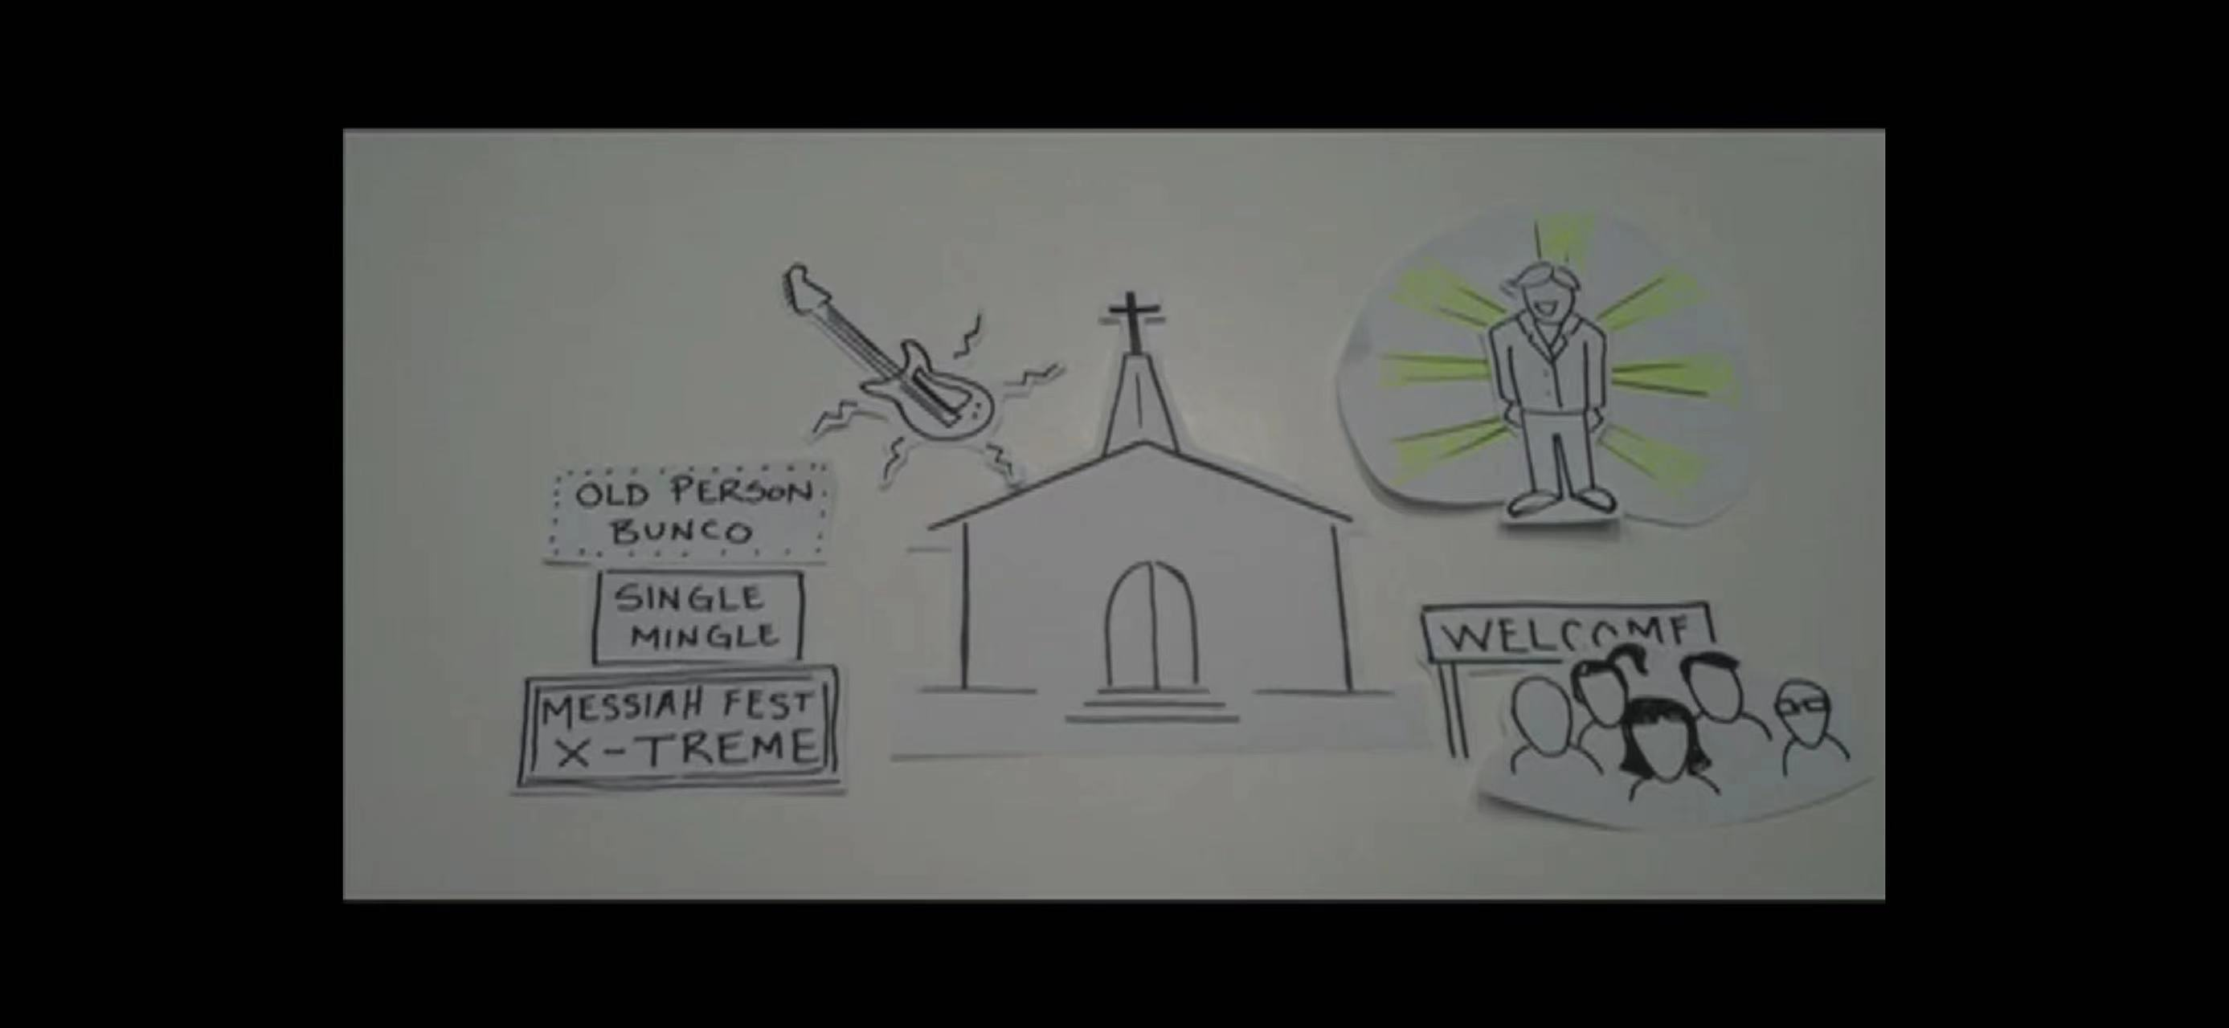

Slide 11
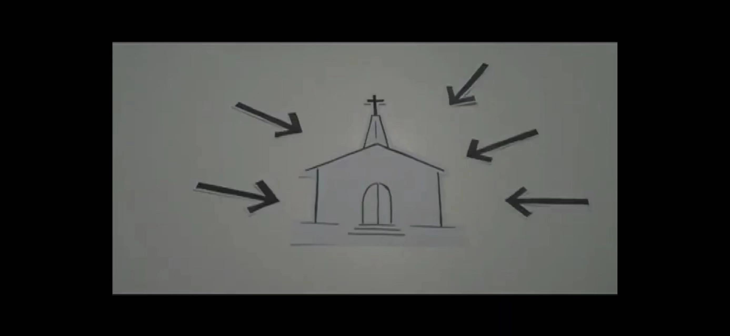

Slide 12
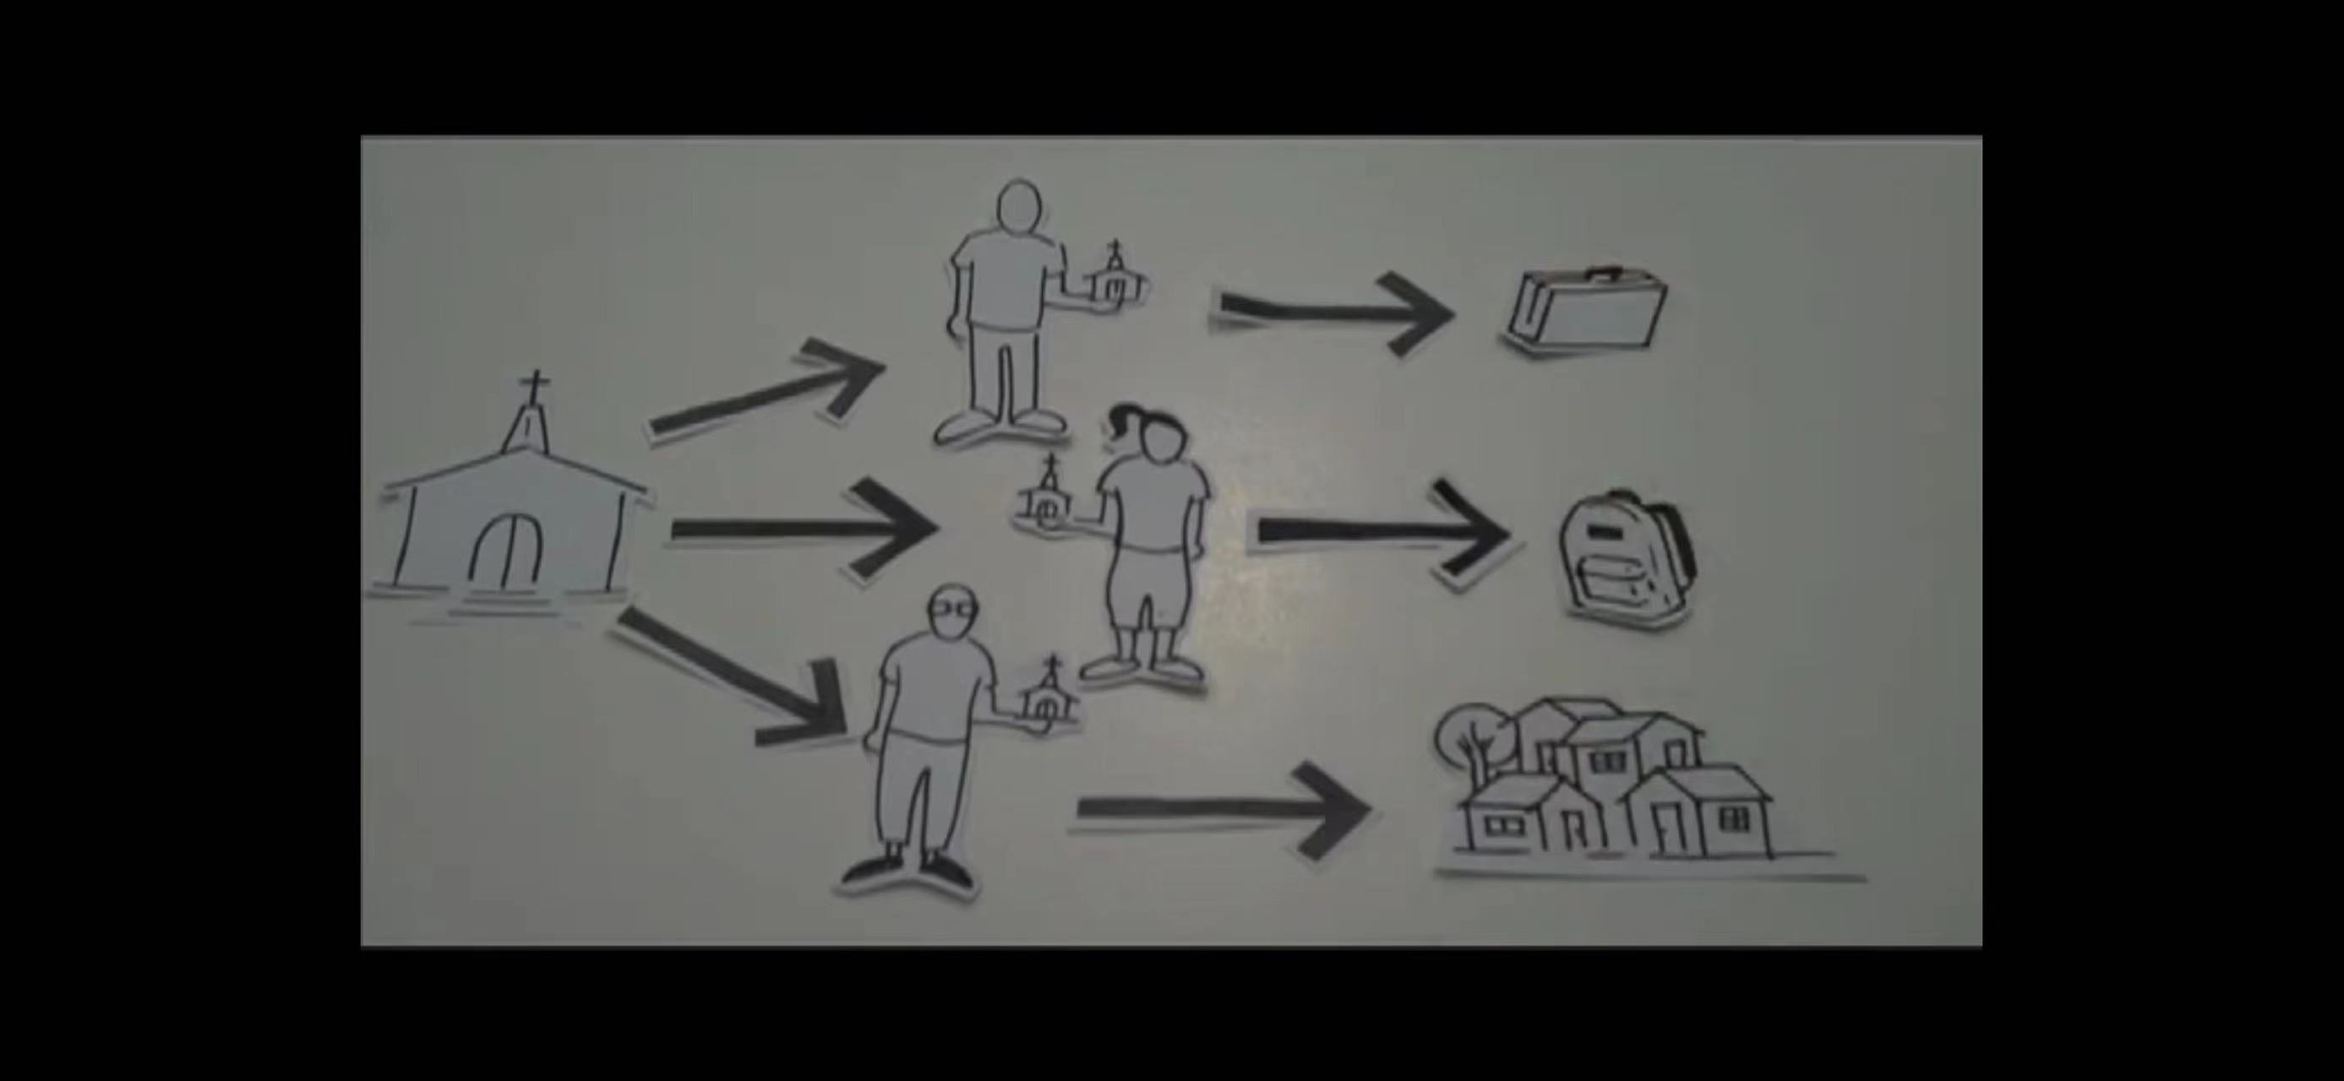

Slide 13
活出上帝赋予的使命 Live out your mission
生命改变-Being transformed
祝福万民-Blessing others
萌神拣选-Being Chosen

Slide 14
华润万家 Chinese华 run 润 into households万家 witnessing Jesus 见证耶稣基督

Slide 15
15

Slide 16
领受永恒之家的祝福
Receive the blessings of eternal Home
诗篇84：1-12
Psalm84：1-12
16

Slide 17
领受永恒之家的祝福
2026年2月15日

