Slide 1


以复活为中心的福音
2026年3月8日

Slide 2
以复活为中心的福音
The Resurrection-Centered Gospel
哥林多前书15：1-11
1 Corinthians 15：1-11
2

Slide 3


Slide 4
一 得救之道（V1，2）
I. The Way of Salvation
1 听到福音；
Hearing the Gospel
2相信并持守福音；
Believing and Holding Fast to the Gospel

Slide 5
二 救恩根本（V3-8）
II. The Foundation of Salvation
1 救恩的最重要内容；
The Essential Content of Salvation
2 救恩的历史可靠性；
The Historical Reliability of Salvation

Slide 6
三 美好见证（V9-11）
III. A Beautiful Witness
1蒙主拣选；
Chosen by the Lord
2 领受使命；
Receiving the Commission

Slide 7
活出上帝赋予的使命 Live out your mission
生命改变-Being transformed
祝福万民-Blessing others
萌神拣选-Being Chosen

Slide 8
华润万家 Chinese华 run 润 into households万家 witnessing Jesus 见证耶稣基督

Slide 9
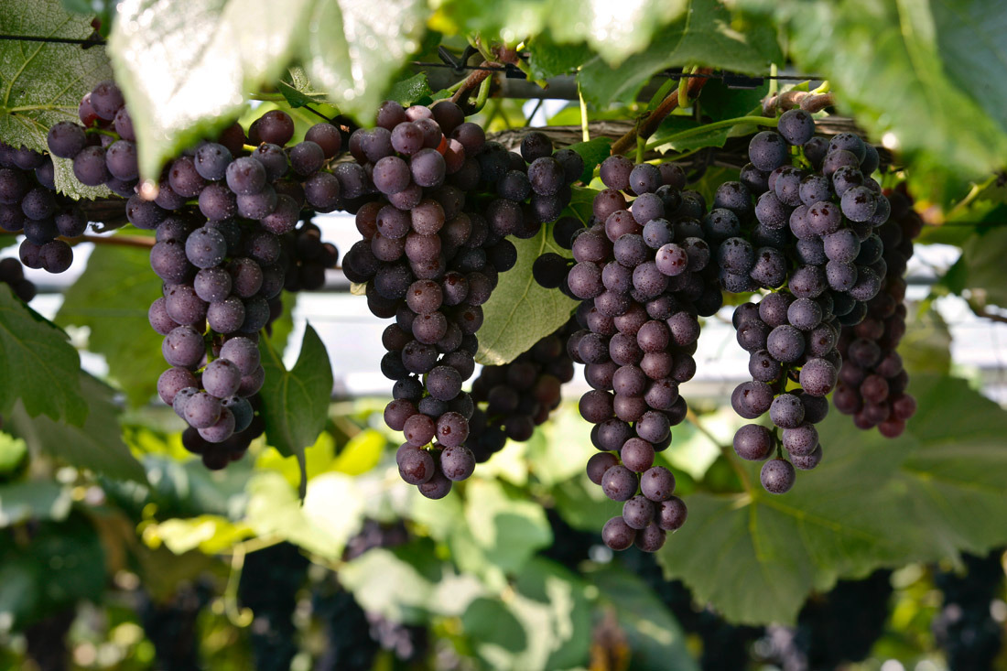
Notes:
parent-Child employer-employee
clerk-customer husband-wife
writer-reader driver-passenger
teacher-student host-guest
buyer-seller doctor-patient
boyfriend-girlfriend performer-audience
siblings, lovers, friends, neighbors, colleagues, schoolmates, classmates, roommates, group members, interviewer and interviewee, lawyer and client, policeman and thief, enemies, rivals, etc.

Slide 11
以复活为中心的福音
2026年3月8日

