Slide 1
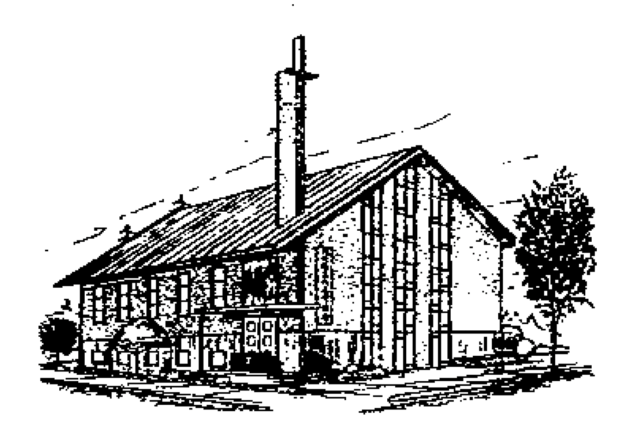
复活的身体
主后2026年4月19日
北临海华人基督教会

Slide 2
使徒信经
The Apostles' Creed

Slide 3
使徒信经The Apostles' Creed
1. 我信上帝，全能的父， 創造天地的主。
1. I believe in God, the Father almighty, creator of heaven and earth.
2. 我信我主耶穌基督，上帝的獨生子；
2. I believe in Jesus Christ, his only Son, our Lord;
3. 因著聖靈感孕，從童貞女馬利亞所生；
3. who was conceived by the Holy Spirit and born of the virgin Mary;
4. 在本丟彼拉多手下受難，被釘在十字架上，受死，埋葬；
4. he suffered under Pontius Pilate, was crucified, died, and was buried;
5. 降在陰間；第三天從死里復活；
5. he descended to hell; the third day he rose again from the dead;
6. 他升天，坐在全能父上帝的右邊；
6. he ascended to heaven and is seated at the right hand of God the Father almighty;

Slide 4
使徒信经The Apostles' Creed
7. 將來必從那里降臨，審判活人，死人。
7. from there he will come to judge the living and the dead.
8. 我信聖靈；
8. I believe in the Holy Spirit,
9. 我信聖而公之教會；我信聖徒相通；
9. the holy and universal church, the communion of saints,
10. 我信罪得赦免，
10. the forgiveness of sins,
11. 我信身體復活；
11. the resurrection of the body,
12. 我信永生。阿們！
12. and the life everlasting. Amen.

Slide 5
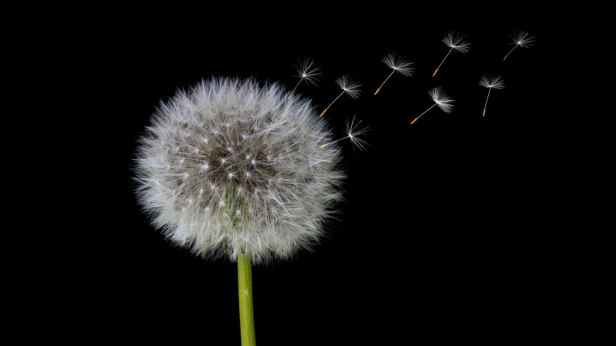
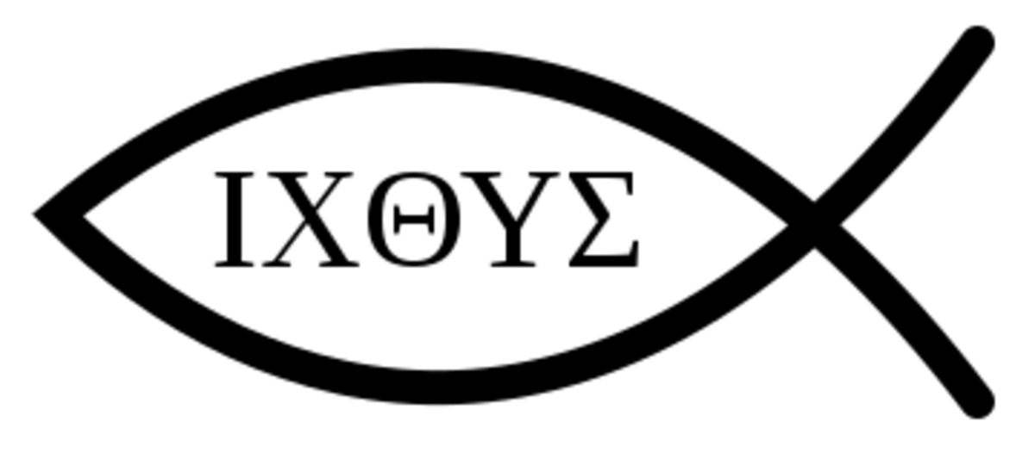
复活的身体
2026年4月19日

Slide 6
复活的身体
哥林多前书 15:35-44
6

Slide 7
一 身体复活的真理坚固圣徒信心（V35）
I. The Truth of Bodily Resurrection Strengthens the Faith of Saints (V35)
1 直面对于信仰根基的追问；
2 回归真理，塑造生命；
Confronting the inquiry into the foundation of faith;
Returning to the truth to shape life;

Slide 8
二 身体复活的真理贯通今生与永恒（V36-41）
II. The Truth of Bodily Resurrection Connects This Life with Eternity (V36-41)
1 不死就不能生；
2 地上的形体与天上的形体
It cannot come to life unless it dies;
Earthly bodies and heavenly bodies

Slide 9
三 身体复活的真理带来天上的盼望（V42-44）III. The Truth of Bodily Resurrection Brings Heavenly Hope (V42-44)
1 认识所种的与复活的
2 盼望不朽坏的、荣耀的与强壮的
Understanding what is sown and what is raised;
Hoping for the imperishable, the glorious, and the powerful.

Slide 10
使徒信经
The Apostles' Creed

Slide 11
使徒信经The Apostles' Creed
1. 我信上帝，全能的父， 創造天地的主。
1. I believe in God, the Father almighty, creator of heaven and earth.
2. 我信我主耶穌基督，上帝的獨生子；
2. I believe in Jesus Christ, his only Son, our Lord;
3. 因著聖靈感孕，從童貞女馬利亞所生；
3. who was conceived by the Holy Spirit and born of the virgin Mary;
4. 在本丟彼拉多手下受難，被釘在十字架上，受死，埋葬；
4. he suffered under Pontius Pilate, was crucified, died, and was buried;
5. 降在陰間；第三天從死里復活；
5. he descended to hell; the third day he rose again from the dead;
6. 他升天，坐在全能父上帝的右邊；
6. he ascended to heaven and is seated at the right hand of God the Father almighty;

Slide 12
使徒信经The Apostles' Creed
7. 將來必從那里降臨，審判活人，死人。
7. from there he will come to judge the living and the dead.
8. 我信聖靈；
8. I believe in the Holy Spirit,
9. 我信聖而公之教會；我信聖徒相通；
9. the holy and universal church, the communion of saints,
10. 我信罪得赦免，
10. the forgiveness of sins,
11. 我信身體復活；
11. the resurrection of the body,
12. 我信永生。阿們！
12. and the life everlasting. Amen.

Slide 13
活出上帝赋予的使命
Live out your mission
生命改变-Being transformed
祝福万民-Blessing others
蒙神拣选-Being Chosen

Slide 14
华润万家
Chinese华 run 润 into households万家 witnessing Jesus
见证耶稣基督

Slide 15
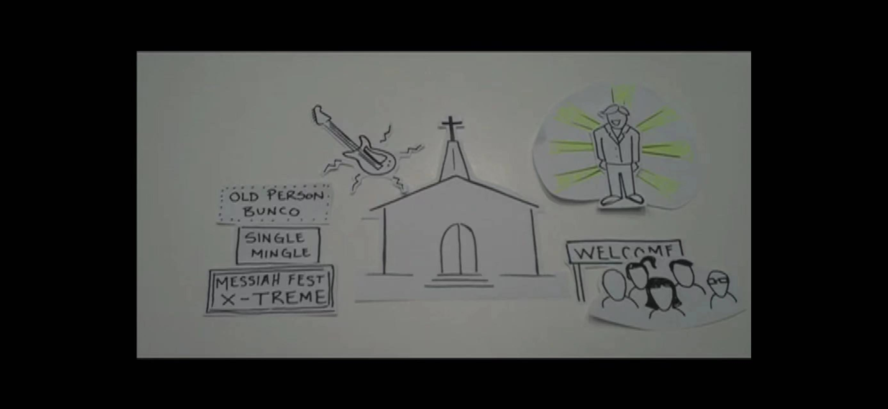

Slide 16
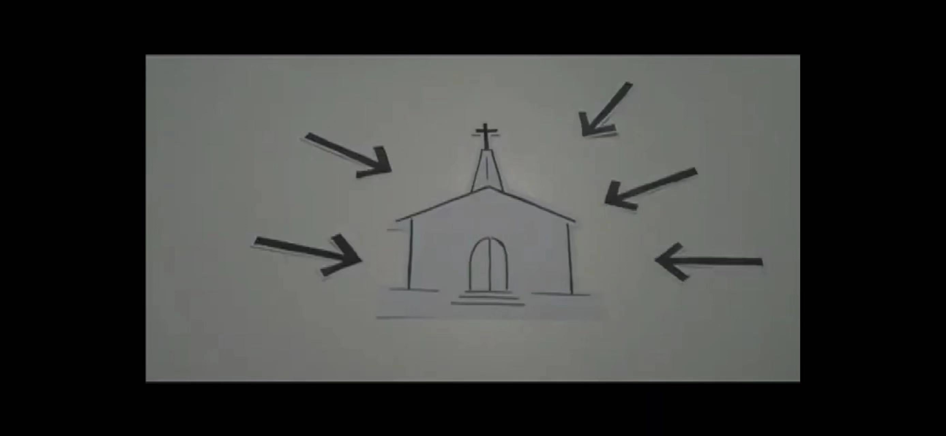

Slide 17
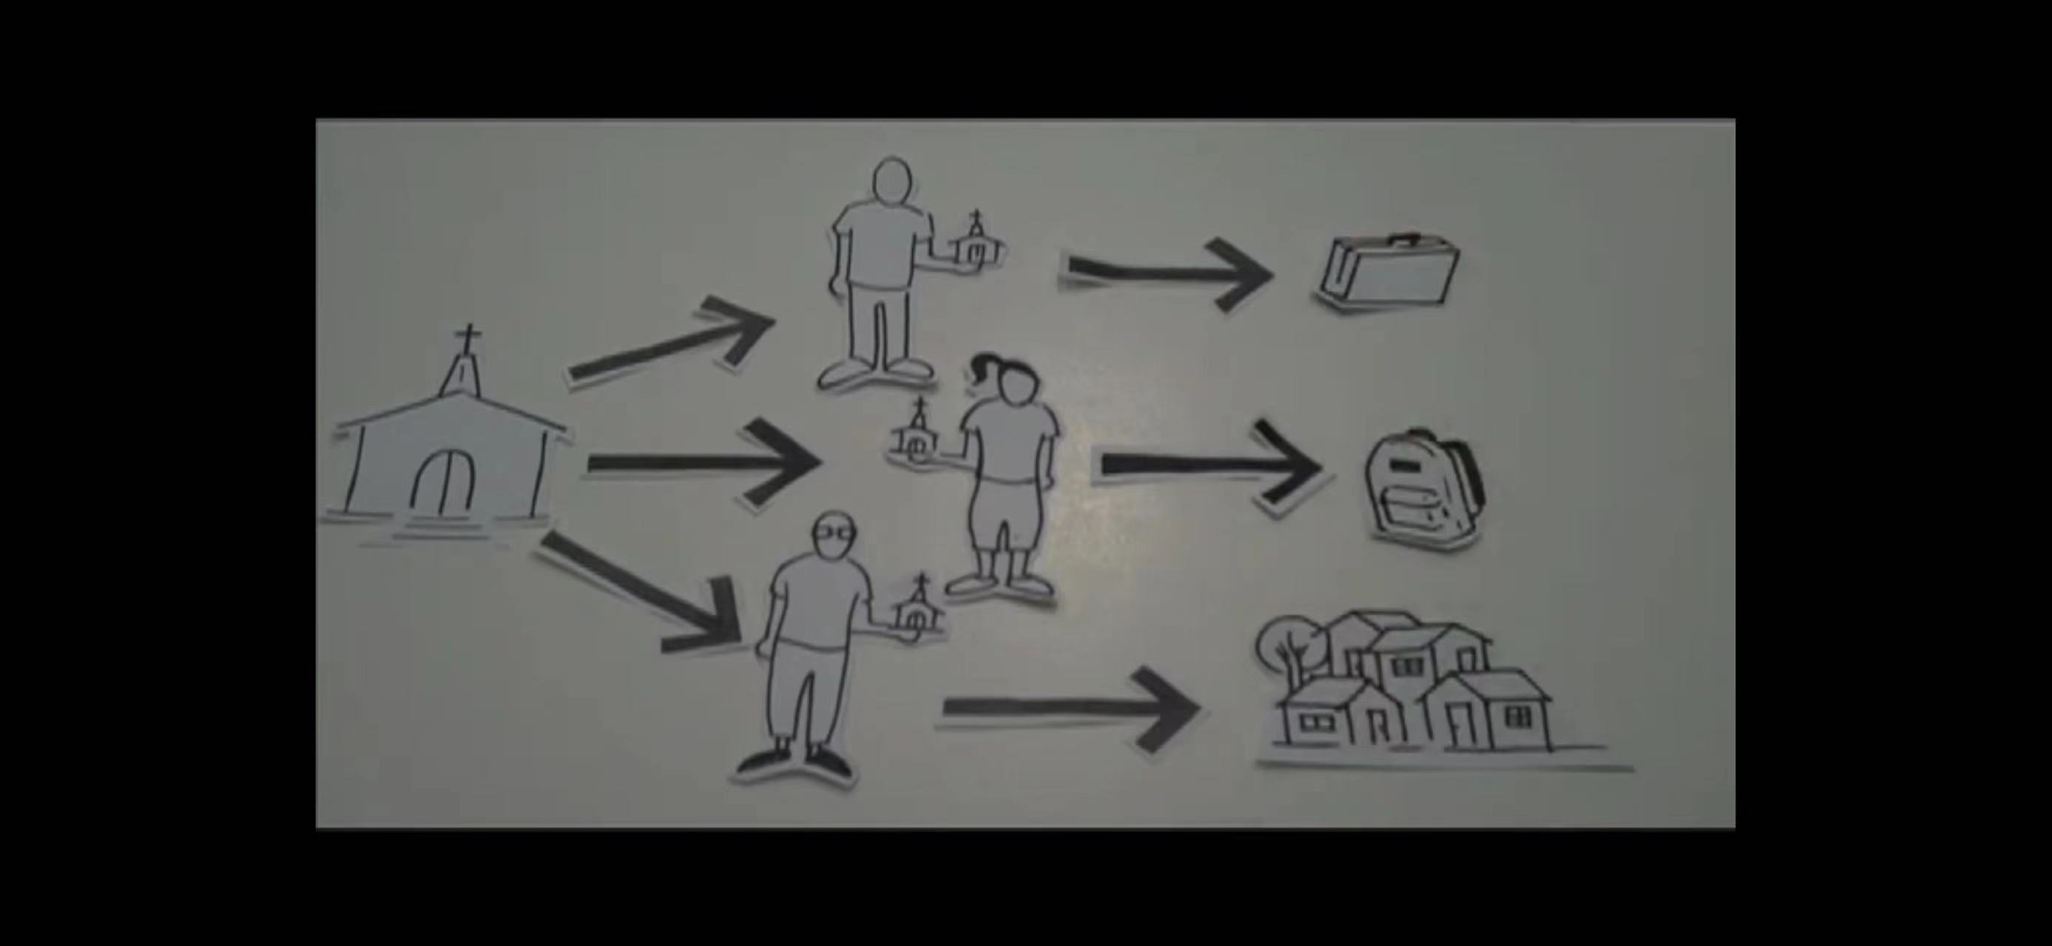

Slide 18
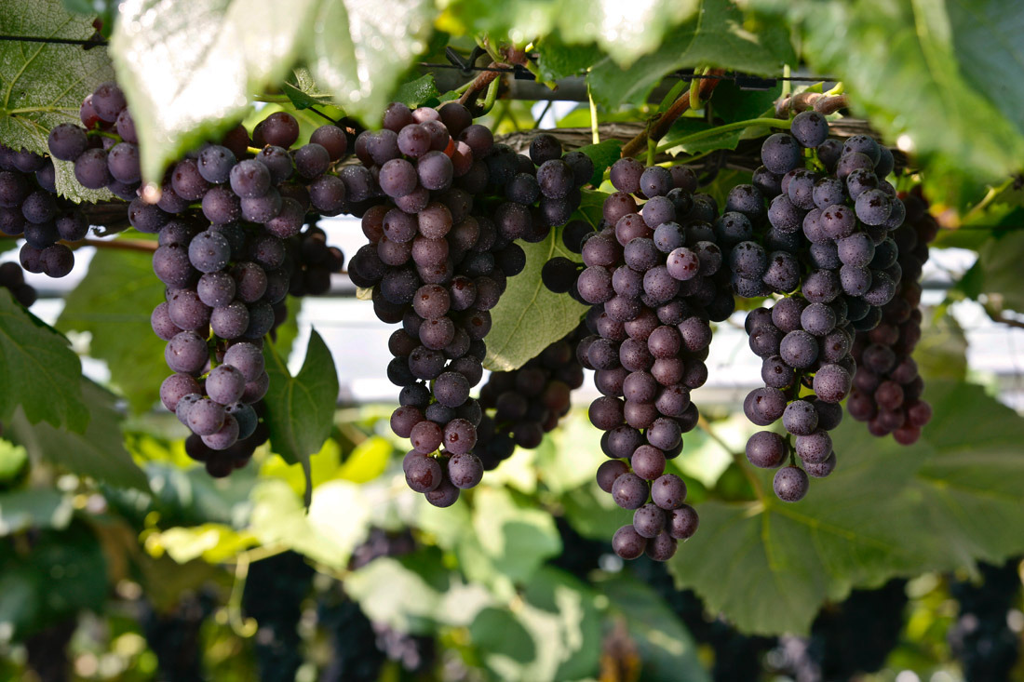
Notes:
parent-Child employer-employee
clerk-customer husband-wife
writer-reader driver-passenger
teacher-student host-guest
buyer-seller doctor-patient
boyfriend-girlfriend performer-audience
siblings, lovers, friends, neighbors, colleagues, schoolmates, classmates, roommates, group members, interviewer and interviewee, lawyer and client, policeman and thief, enemies, rivals, etc.

