Slide 1


聚會即將開始
Service is about to begin
預備心迎見神
Prepare heart to meet with God

Slide 2
请安静我们的心，开始主日敬拜
Let us quiet our hearts and begin our Sunday worship

Slide 3
宣 召
Call to Worship

Slide 4
17 主手所造
All Creatures of Our God and King
1/4
主手所造萬象生靈
同發聲音讚美真神
哈利路亞 哈利路亞
All creatures of our God and King
Lift up your voice and with us sing
Alleluia Alleluia

Slide 5
17 主手所造
All Creatures of Our God and King
1/4
溫柔明月 光耀日輪
狂風 密雲 清晨 黃昏
讚美真神 讚美真神
哈利路亞 哈利路亞 哈利路亞
Thou burning sun with golden beam
Thou silver moon with softer gleam
O praise Him O praise Him
Alleluia Alleluia Alleluia

Slide 6
17 主手所造
All Creatures of Our God and King
2/4
清清河水長流不歇
熊熊烈火供人光熱
哈利路亞 哈利路亞
Thou rushing wind that art so strong
Ye clouds that sail in heav’n along
O praise Him Alleluia

Slide 7
17 主手所造
All Creatures of Our God and King
2/4
大地高山無盡寶藏
滋生萬物花草芬芳
讚美真神讚美真神
哈利路亞 哈利路亞 哈利路亞
Thou rising morn in praise rejoice
Ye lights of evening find a voice
O praise Him O praise Him
Alleluia Alleluia Alleluia

Slide 8
17 主手所造
All Creatures of Our God and King
3/4
仁心世人遵守生命
饒恕弟兄 榮神益人
哈利路亞 哈利路亞
And all ye men of tender heart
Forgiving others take your part
O sing ye Alleluia

Slide 9
17 主手所造
All Creatures of Our God and King
3/4
世人饱受痛苦忧惊
速将忧虑卸给真神
赞美真神 赞美真神
哈利路亚 哈利路亚 哈利路亚
Ye who long pain and sorrow bear
Praise God and on Him cast your care
O praise Him O praise Him
Alleluia Alleluia Alleluia

Slide 10
17 主手所造
All Creatures of Our God and King
4/4
萬物讚美造物主宰
都當謙卑向主敬拜
哈利路亞 哈利路亞
Let all things their Creator bless
And worship Him in humbleness
O praise Him Alleluia

Slide 11
17 主手所造
All Creatures of Our God and King
4/4
讚美聖父聖子聖靈
同聲讚美三一真神
讚美真神 讚美真神
哈利路亞 哈利路亞 哈利路亞
Praise praise the Father praise the Son
And praise the Spirit Thee in One
O praise Him O praise Him
Alleluia Alleluia Alleluia

Slide 12
禱告
Prayer

Slide 13
閱讀經文： 诗篇 103
叫以色列人晓得他的作为。耶和华有怜悯，有恩典，不轻易发怒，且有丰盛的慈爱。他不长久责备，也不永远怀怒。他没有按我们的罪过待我们，
也没有照我们的罪孽报应我们。天离地何等的高， 他的慈爱向敬畏他的人也是何等的大！东离西有多远, 他叫我们的过犯离我们也有多远！父亲怎样怜恤他的儿女，耶和华也怎样怜恤敬畏他的人！

Slide 14
閱讀經文： 诗篇 103
因为他知道我们的本体，思念我们不过是尘土。 至于世人，他的年日如草一样。他发旺如野地的花，经风一吹，便归无有；它的原处也不再认识它。但耶和华的慈爱归于敬畏他的人，从亘古到永远；他的公义也归于子子孙孙 ，就是那些遵守他的约、记念他的训词而遵行的人。耶和华在天上立定宝座；他的权柄统管万有。 听从他命令、

Slide 15
獻 詩 Praise

Slide 16
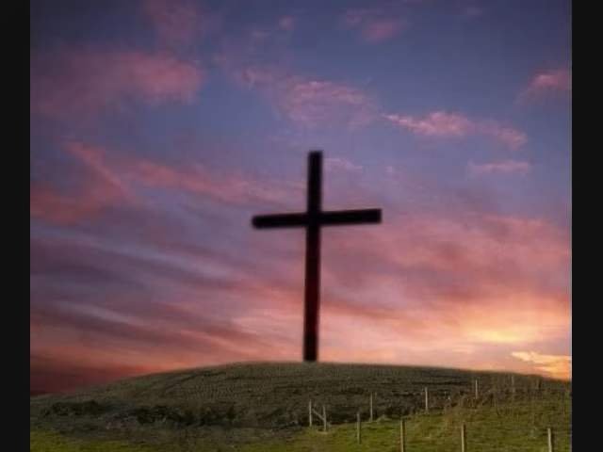

Slide 17
使徒信经
The Apostles' Creed

Slide 18
使徒信经 The Apostles' Creed
1. 我信上帝，全能的父， 創造天地的主。
2. 我信我主耶穌基督，上帝的獨生子；
3. 因著聖靈感孕，從童貞女馬利亞所生；
4. 在本丟彼拉多手下受難，被釘在十字架上，受死，埋葬；
5. 降在陰間；第三天從死里復活；
6. 他升天，坐在全能父上帝的右邊；
7. 將來必從那里降臨，審判活人，死人。
8. 我信聖靈；
9. 我信聖而公之教會；我信聖徒相通；
10. 我信罪得赦免，
11. 我信身體復活；
12. 我信永生。阿們！

Slide 19
The Apostles' Creed
1. I believe in God, the Father almighty, creator of heaven and earth.
2. I believe in Jesus Christ, his only Son, our Lord;
3. who was conceived by the Holy Spirit and born of the virgin Mary;
4. he suffered under Pontius Pilate, was crucified, died, and was buried;
5. he descended to hell; the third day he rose again from the dead;
6. he ascended to heaven and is seated at the right hand of God the Father almighty;
7. from there he will come to judge the living and the dead.
8. I believe in the Holy Spirit,
9. the holy and universal church, the communion of saints,
10. the forgiveness of sins,
11. the resurrection of the body,
12. and the life everlasting. Amen.

Slide 20

“时刻准备好”的日常生活
A Daily Life of Being Always Ready
主后2026年5月24日
北临海华人基督教会

Slide 21
“时刻准备好”的日常生活
A Daily Life of Being Always Ready
哥林多前书 16:1-12
21

Slide 22
一 敬拜的操练（V1-4）
I. The Practice of Worship (vv. 1–4)
为圣徒捐钱与给上帝的奉献；
Giving to the saints and offerings to God;
预留与现凑
Setting aside in advance versus giving on the spot

Slide 23
二 爱心的操练（V5-9）
II. The Practice of Love (vv. 5–9)
出于善意和爱心的安排
Plans made out of goodwill and love
出于长久祝福的调整
Adjustments made for long-term blessing

Slide 24
三 品格的操练（V10-12）
III. The Practice of Character (vv. 10–12)
提摩太与亚波罗
Timothy and Apollos
言行一致的榜样
Life Example

Slide 25
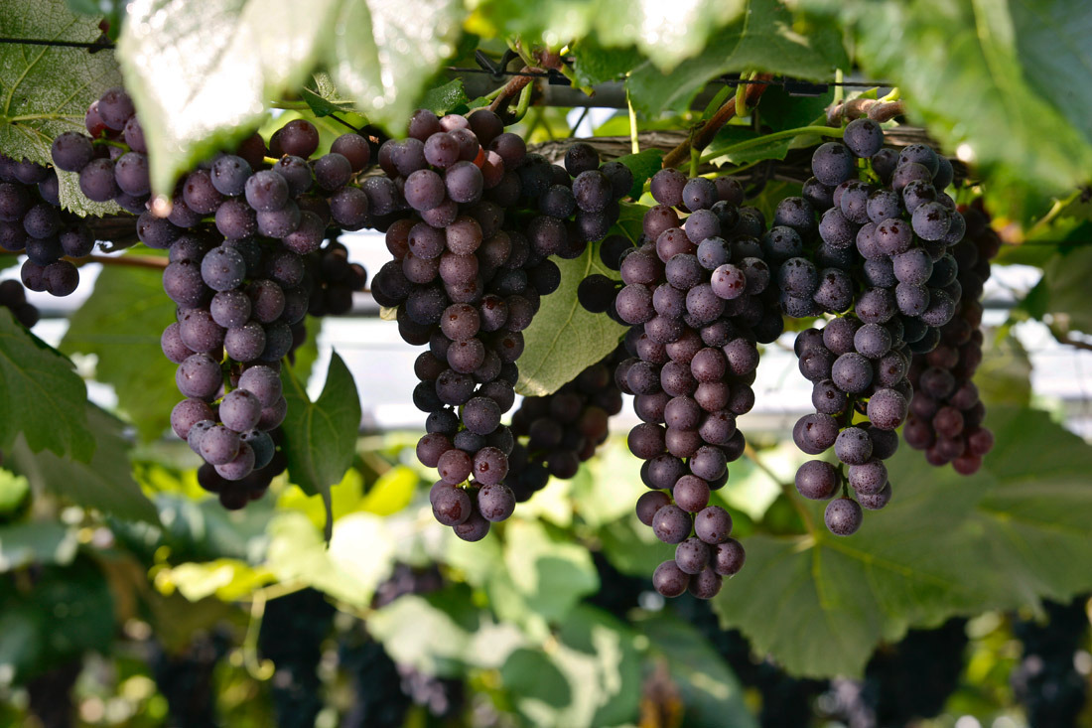
Notes:
parent-Child employer-employee
clerk-customer husband-wife
writer-reader driver-passenger
teacher-student host-guest
buyer-seller doctor-patient
boyfriend-girlfriend performer-audience
siblings, lovers, friends, neighbors, colleagues, schoolmates, classmates, roommates, group members, interviewer and interviewee, lawyer and client, policeman and thief, enemies, rivals, etc.

Slide 26

Second YouTube Song
Replace this slide with a slide that has the downloaded YouTube song
1/5

Slide 27
報告與代禱事項 Announcement & Prayer Requests

Slide 28
Membership qualification revision
Current text:
Article 1 Membership Qualifications
Any person who has accepted Jesus Christ as their Savior and Lord, genuinely repented, and has been born again by the Holy Spirit and received baptism in this church should be a member of this church.
Believers who have been baptized in other churches and are willing to participate in various gatherings in this church, observe the Lord's Supper, fulfill their duties as believers, serve the Lord zealously, and accept and follow the bylaws of this church may apply to become a member of this church, and after being accepted by the deacon board and approved by two-thirds majority vote, with a minimum of 50% of general assembly voting, shall become a member.

Slide 29
Membership qualification revision
Proposed revision:
Article 1 Membership Qualifications
Any person who has accepted Jesus Christ as their Savior and Lord, genuinely repented, and has been born again by the Holy Spirit and received baptism in this church should be a member of this church.
Believers who have been baptized in other churches and are willing to participate in various gatherings in this church, observe the Lord's Supper, fulfill their duties as believers, serve the Lord zealously, and accept and follow the bylaws of this church may apply to become a member of this church, and after being accepted by the deacon board and approved by two-thirds majority vote, with a minimum of 50% of general assembly voting, shall become a member.

Slide 30
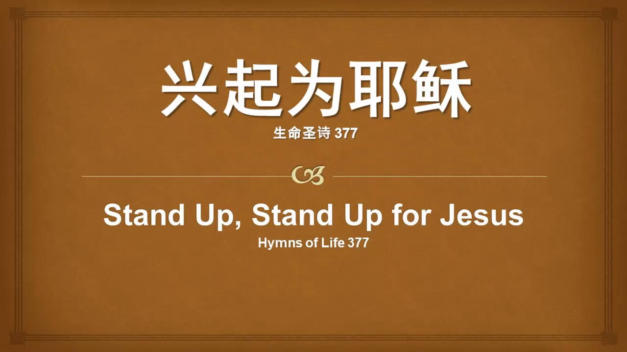
Third YouTube Song
Replace this slide with a slide that has the downloaded YouTube song
1/5

Slide 31
祝福 Benediction

Slide 32
殿 樂
Postlude
（請靜默至殿樂結束）
Please remain quietly seated until postlude is ended

Slide 33
主日学
Sunday School

