Slide 1
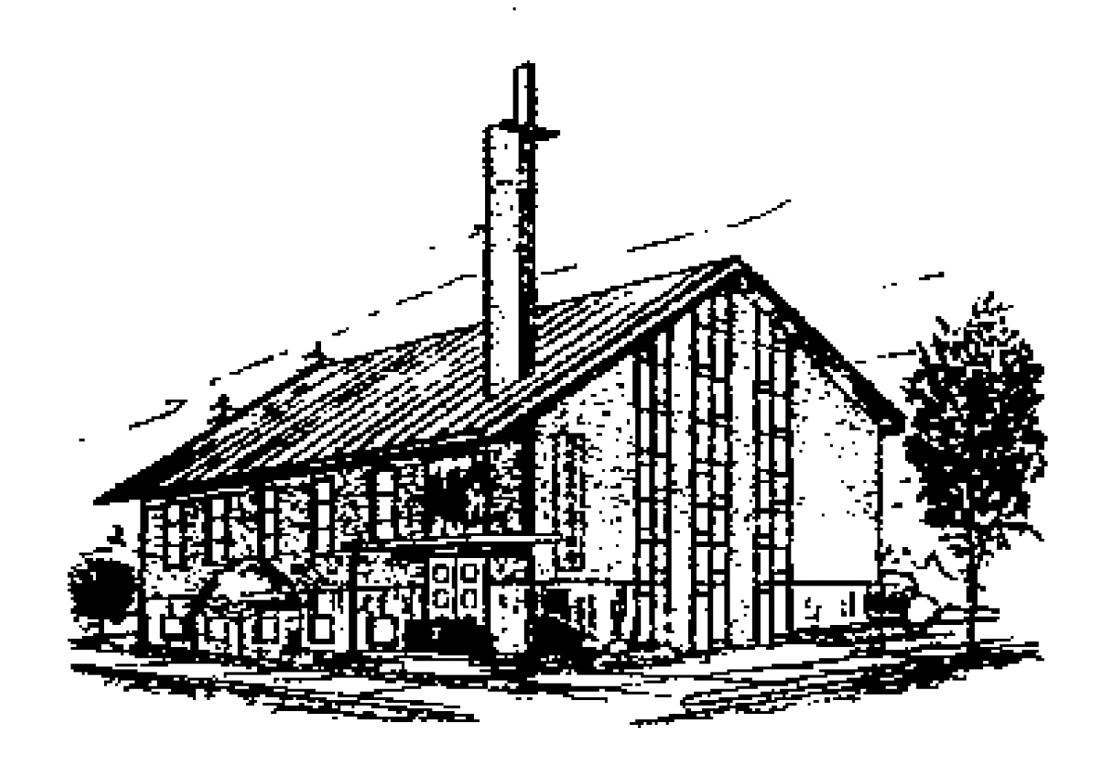
天父如何塑造父亲
How the Heavenly Father shapes fathers？
主后2026年6月21日
北临海华人基督教会

Slide 2
天父如何塑造父亲
How the Heavenly Father shapes fathers？
希伯来书12:10,11
Hebrews12:10,11
2

Slide 3
一、 天父初始的塑造：活在父亲的阴影下
I. God's Initial Shaping: Living Under the Shadow of the Father
活在父亲的偏爱中。
1) Living within the father’s favoritism.
活在父亲的保护中。
2) Living within the father’s protection.
活在父亲的主宰中。
3) Living under the father’s dominance.

Slide 4
二天父进深的塑造：成年后面对自己的软弱
II. God's Deepening Shaping: Facing One's Own Weaknesses in Adulthood
胜过恐惧-承担作家长的责任。
1) Overcoming fear—taking on the responsibility of being the head of the household.
胜过恐惧-承担作丈夫的责任。
2) Overcoming fear—taking on the responsibility of being a husband.
胜过恐惧-承担作父亲的责任。
3) Overcoming fear—taking on the responsibility of being a father.

Slide 5
三、 天父终极的塑造：依靠天父的恩典学习作父亲
III. God's Ultimate Shaping: Learning to Be a Father by Relying on God's Grace
因为顺服上帝而顺服父亲
1) Obeying the father because of obedience to God.
上帝主动施恩，帮助他胜过恐惧。
2) God taking the initiative to bestow grace, helping him overcome fear.
上帝在他终生施行拯救。
3) God working salvation throughout his entire life.

Slide 6
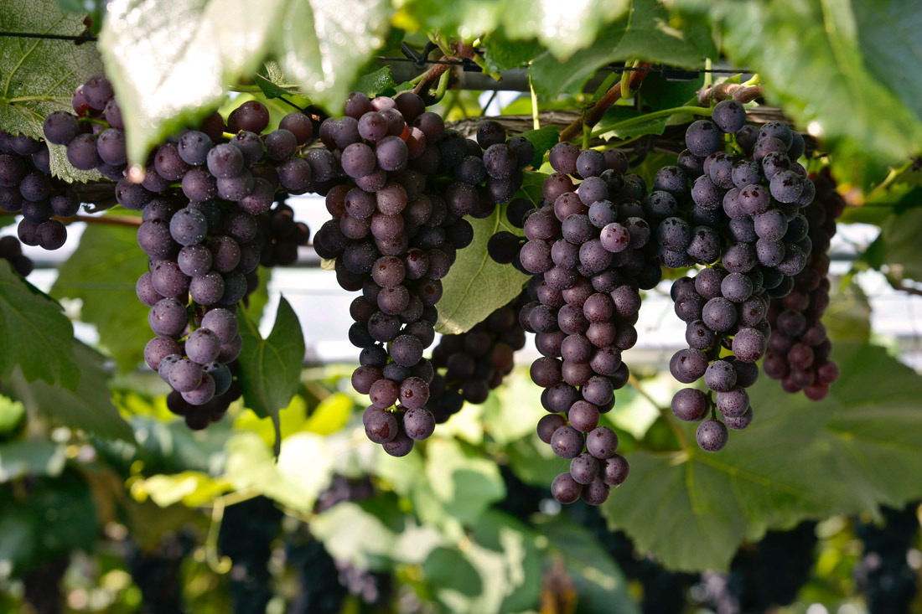
Notes:
parent-Child employer-employee
clerk-customer husband-wife
writer-reader driver-passenger
teacher-student host-guest
buyer-seller doctor-patient
boyfriend-girlfriend performer-audience
siblings, lovers, friends, neighbors, colleagues, schoolmates, classmates, roommates, group members, interviewer and interviewee, lawyer and client, policeman and thief, enemies, rivals, etc.

