Slide 1

我們 都 為這事 作 見證 and of that we all are witnesses.
主后2026年6月28日
北临海华人基督教会

Slide 2
我們 都 為這事 作 見證
and of that we all are witnesses.
使徒行传2:22-42
Acts 2: 22-42
2

Slide 3
一 见证福音的信息（V22-24，36）
I. Witnessing The Message of the Gospel (v. 22-24, 36)
一 见证福音的信息（V22-24，36）
I. Witnessing The Message of the Gospel (v. 22-24, 36)
1见证耶稣基督的复活；
1 Witnessing the resurrection of Jesus Christ;
2 见证耶稣基督是救世主
2. Witnessing that Jesus Christ is the Savior
.

Slide 4
二 见证福音的能力（25-35）
II. Witnessing The Power of the Gospel (v. 25-35)
见证圣灵的启示；
1 Witnessing the revelation of the Holy Spirit;
2 见证生命的改变；
2. Witnessing the transformation of life;

Slide 5
三见证福音的使命（V37-42）
III. Witnessing the Gospel as The Mission (v. 37-42)
见证上帝的呼召；
1 Witnessing the call of God to all;
见证信仰的真意；
2 Witnessing the true meaning of faith;

Slide 6
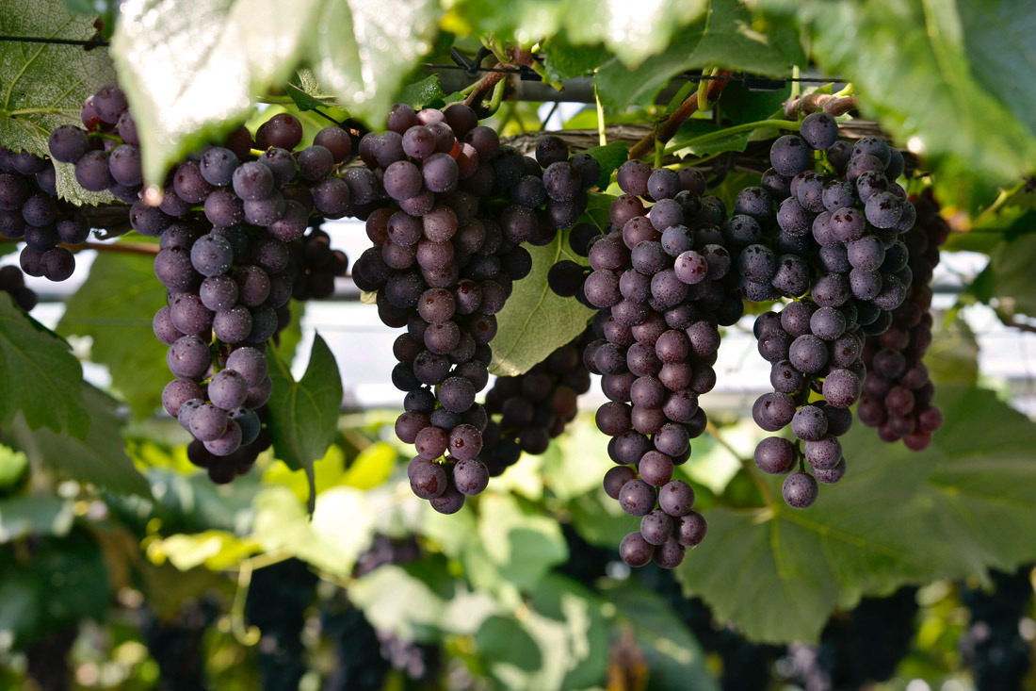
Notes:
parent-Child employer-employee
clerk-customer husband-wife
writer-reader driver-passenger
teacher-student host-guest
buyer-seller doctor-patient
boyfriend-girlfriend performer-audience
siblings, lovers, friends, neighbors, colleagues, schoolmates, classmates, roommates, group members, interviewer and interviewee, lawyer and client, policeman and thief, enemies, rivals, etc.

