Slide 1
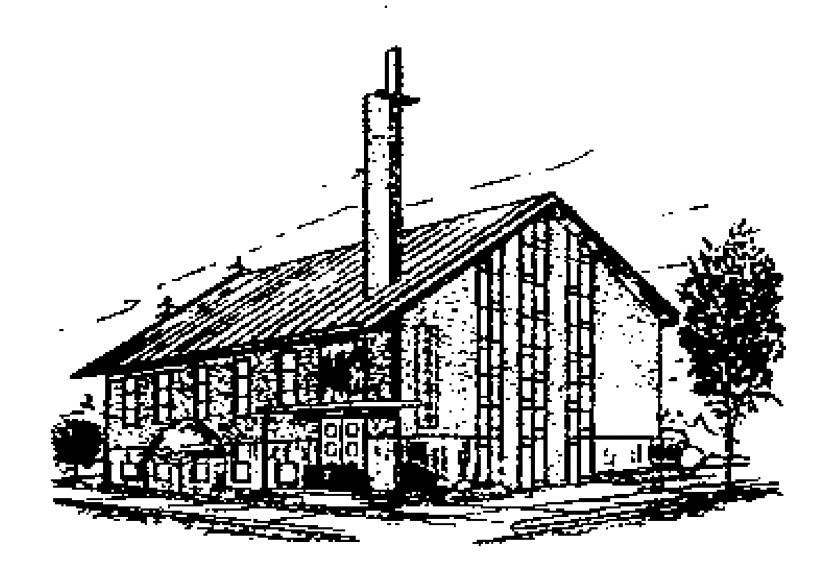
认识上帝对仆人的保护
Understanding God's Protection for His Servants
主后2026年7月5日
北临海华人基督教会

Slide 2
认识上帝对仆人的保护
Understanding God's Protection for His Servants
尼希米记6:1-19
Nehemiah 6:1-19
2

Slide 3
一上帝保守圣徒胜过攻击（V1-9）
I. God Preserves the Saints to Overcome Attacks (vv. 1-9)
面对攻击；Facing attacks;
凭信心胜过；Overcoming by faith;

Slide 4
二上帝保守圣徒胜过欺骗（V10-14）
II. God Preserves the Saints to Overcome Deception (vv. 10-14)
面对欺骗；Facing deception;
凭信心胜过；Overcoming by faith;

Slide 5
三上帝保守圣徒胜过背叛（V15-19）
III. God Preserves the Saints to Overcome Betrayal (vv. 15-19)
面对背叛；Facing betrayal;
凭信心胜过；Overcoming by faith;

Slide 6
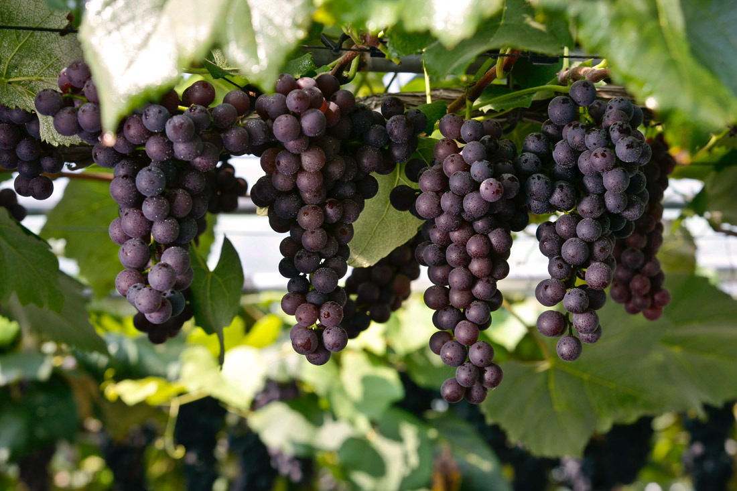
Notes:
parent-Child employer-employee
clerk-customer husband-wife
writer-reader driver-passenger
teacher-student host-guest
buyer-seller doctor-patient
boyfriend-girlfriend performer-audience
siblings, lovers, friends, neighbors, colleagues, schoolmates, classmates, roommates, group members, interviewer and interviewee, lawyer and client, policeman and thief, enemies, rivals, etc.

