Slide 1
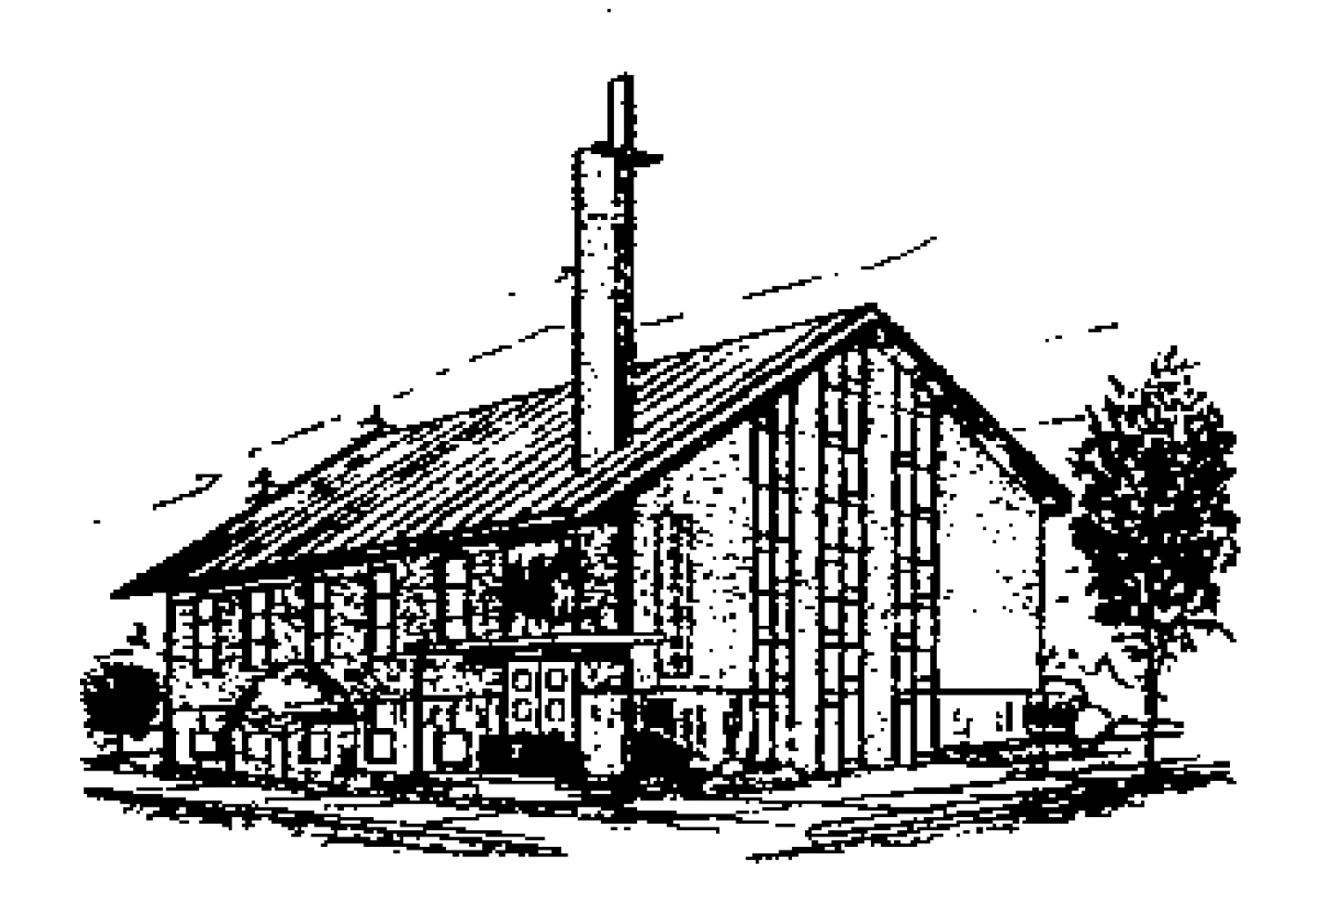
藉真道建造教会
Building the Church
Through the Word of Truth
第二堂
Session 2
主后2026年7月18日
北临海华人基督教会

Slide 2
第二堂:“在地上萬族中，我只認識你們”
-選民的特權與責任。
Session 2: "You only have I known of all the families of the earth"
—The Privilege and Responsibility of the Chosen People.
摩3:1-15Amos 3:1-15
2

Slide 3
一 選民的特權（3：1，2）
I. The Privilege of the Chosen People (3:1, 2)
1你們全 家 是 我從埃及 地 領上來的；
1The whole family that I brought up from the land of Egypt;
2 在地上 萬 族中，我只 認識 你們；
2. You only have I known of all the families of the earth;

Slide 4
二 選民的責任（3：3-8）
II. The Responsibility of the Chosen People (3:3-8)
1 二 人若 不 同心，豈能同 行呢；
1Do two walk together, unless they have agreed to meet;
2 主 耶和華 發命追討罪孽；
2. The Lord God speaks to punish iniquity;

Slide 5
三 選民的刑罰（3：9-15）
III. The Punishment of the Chosen People (3:9-15)
1 城中 有何等大的 擾亂 與欺壓；
1How great are the tumults and the oppressions in the city;
2 當聽這話，警戒 雅各 家；
2. Hear and testify against the house of Jacob;

Slide 6
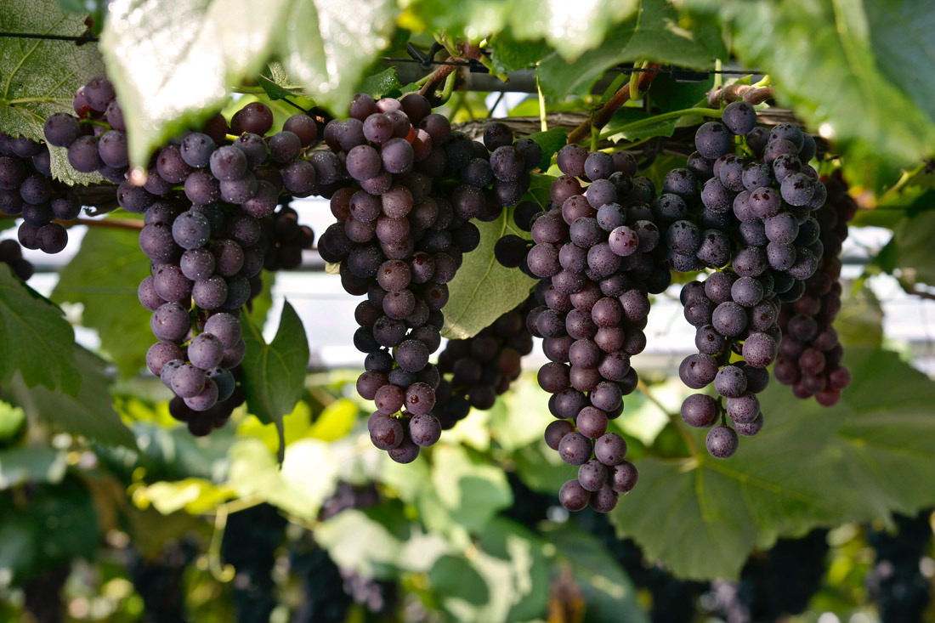
Notes:
parent-Child employer-employee
clerk-customer husband-wife
writer-reader driver-passenger
teacher-student host-guest
buyer-seller doctor-patient
boyfriend-girlfriend performer-audience
siblings, lovers, friends, neighbors, colleagues, schoolmates, classmates, roommates, group members, interviewer and interviewee, lawyer and client, policeman and thief, enemies, rivals, etc.

