Slide 1

藉真道建造教会
Building the Church
Through the Word of Truth
第三堂
Session 3
主后2026年7月18日
北临海华人基督教会

Slide 2
第三堂：“当听我的话”
-上帝对选民的控诉。
Session 3: "Hear this word“
—God's Indictment of the Chosen People.
摩4:1-5:17
Amos 4:1-5:17
2

Slide 3
一 当听我的话（4：1-13）
I. Hear This Word (4:1-13)
1任凭你们加增罪过；
1Letting you multiply transgression;
2 你們仍不 歸 向我；
2. Yet you did not return to me;

Slide 4
二 要聽 我 為你們 所 作的 哀歌（5：1-13）
II. Hear This Word That I Take Up Over You in Lamentation (5:1-13)
1 何等的罪恶！
1What great evil!
2 寻求上帝仍可存活！
2. Seek God and live!

Slide 5
三抓住哀号中的盼望（5：14-17）
III. Grasping Hope in the Midst of Wailing (5:14-17)
1 “我必从你中间经过”；
1"I will pass through your midst";
2 上帝要向余民施恩；
2. God will be gracious to the remnant;

Slide 6
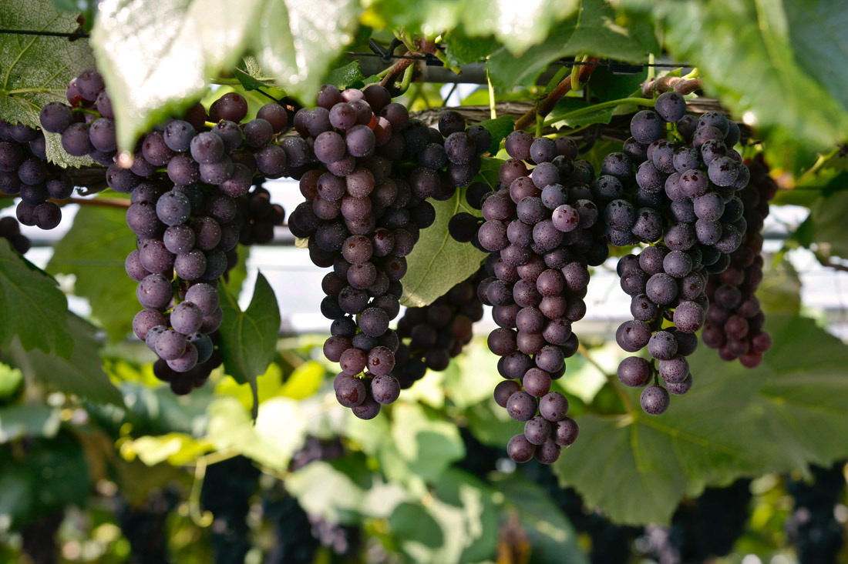
Notes:
parent-Child employer-employee
clerk-customer husband-wife
writer-reader driver-passenger
teacher-student host-guest
buyer-seller doctor-patient
boyfriend-girlfriend performer-audience
siblings, lovers, friends, neighbors, colleagues, schoolmates, classmates, roommates, group members, interviewer and interviewee, lawyer and client, policeman and thief, enemies, rivals, etc.

