Slide 1
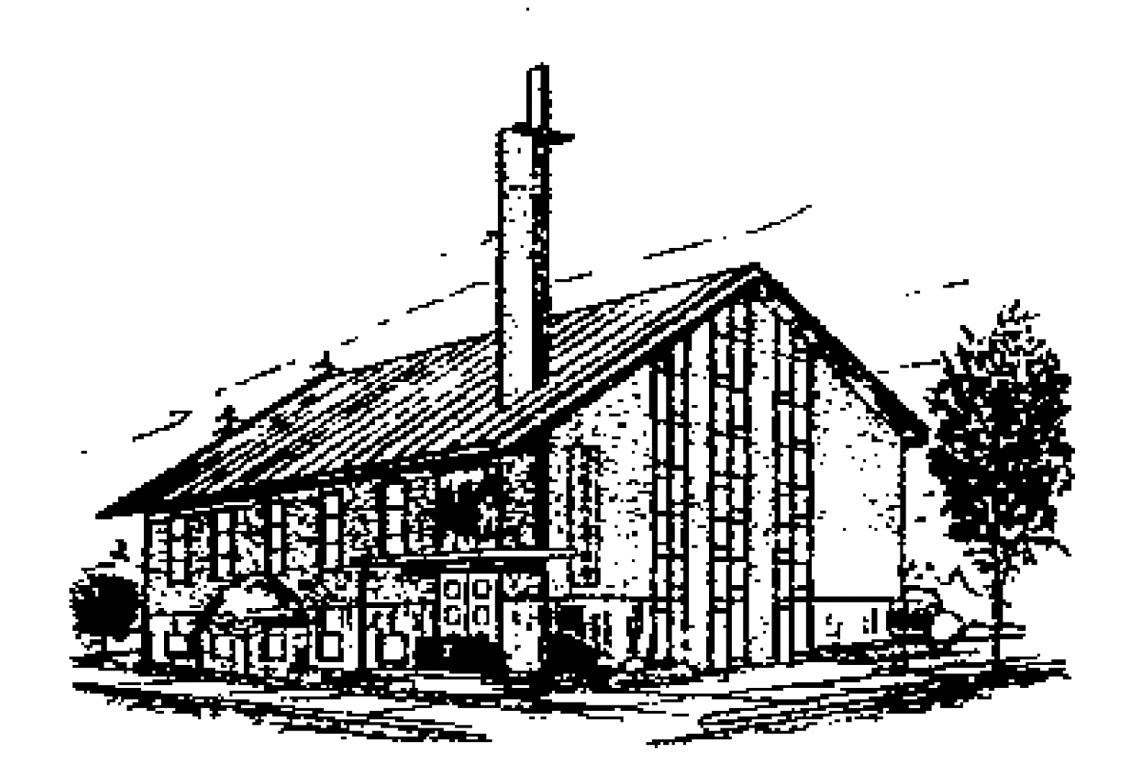
藉真道建造教会
Building the Church
Through the Word of Truth
第四堂
Session 4
主后2026年7月19日
北临海华人基督教会

Slide 2
第四堂:“到那日，我必建立大卫倒塌的帐幕”
-超越审判的恩典。
Session 4: "In that day I will raise up the booth of David that is fallen“
—Grace Beyond Judgment.
摩9:1-15
Amos 9:1-15
2

Slide 3
一 定住 眼目的审判（9：1-10）
I. The Judgment of Fixing the Eyes (9:1-10)
1主的眼目 察看這有罪的國；
1 The eyes of the Lord God are upon the sinful kingdom;
2 国灭家存；
2. The kingdom destroyed, the house preserved;

Slide 4
二 重新修造（9：11，12）
II. Rebuilding Anew (9:11, 12)
1 堵住 其中的破口；
1Repairing its breaches;
2 把那破壞的 建立起來；
2. Raising up its ruins;

Slide 5
三 日子 將到（9：13-15）
III. The Days Are Coming (9:13-15)
1 我必使我民以色列 被擄的 歸回；
1I will restore the fortunes of my people Israel;
2 栽 於 本地，不再拔出；
2. Planted upon their land, never again to be uprooted;

Slide 6
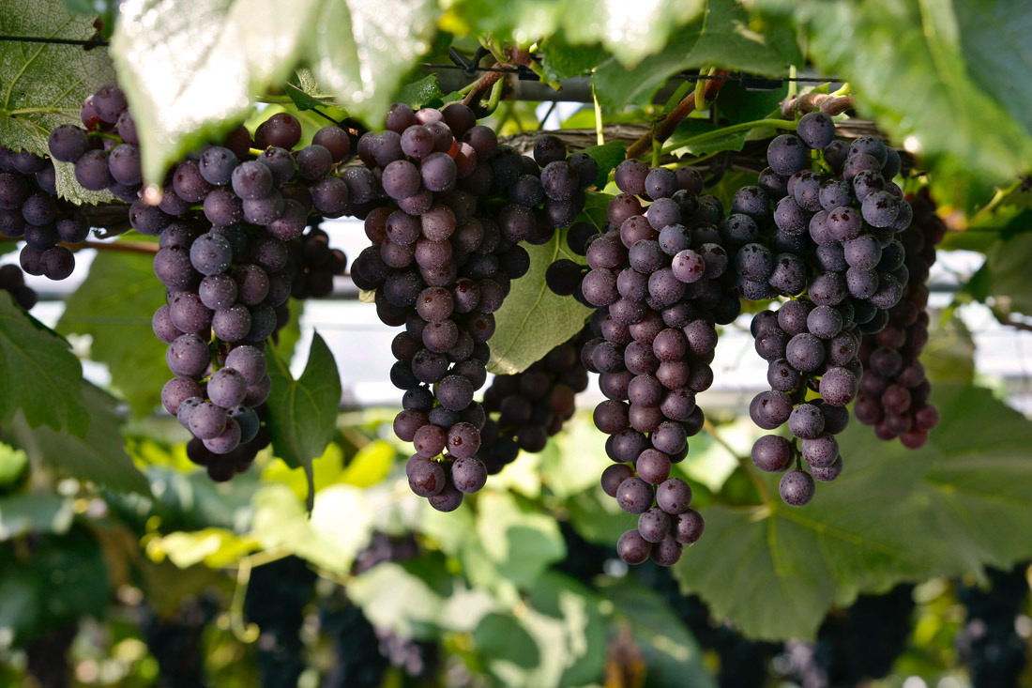
Notes:
parent-Child employer-employee
clerk-customer husband-wife
writer-reader driver-passenger
teacher-student host-guest
buyer-seller doctor-patient
boyfriend-girlfriend performer-audience
siblings, lovers, friends, neighbors, colleagues, schoolmates, classmates, roommates, group members, interviewer and interviewee, lawyer and client, policeman and thief, enemies, rivals, etc.

